Slide 1
BREAST Cancer Prediction Analysis
Presented by:
AAHANA R
ABHINAYA K

Slide 2
INTRODUCTION
Breast cancer prediction is crucial for early detection and improving treatment outcomes, particularly in the healthcare sector. This project utilizes patient data and machine learning techniques to predict the likelihood of breast cancer based on factors such as age, family history, genetic mutations, and lifestyle factors.
It involves:
Data Collection: Gathering medical records, imaging data, and lifestyle information related to breast health.
Data Preprocessing: Cleaning, normalizing, and encoding the data for analysis to ensure quality and consistency.
Model Development: Implementing predictive models like Logistic Regression, Random Forest, or Neural Networks to achieve high accuracy in predicting breast cancer risk.

Slide 3
ABOUT DATASET
The dataset is sourced from Kaggle and includes columns specific to patient data and breast cancer risk factors. The columns consist of the following details:
Age: Records the age of the patient, helping to identify age-related risks for breast cancer.
Family History: Indicates whether there is a genetic predisposition to breast cancer due to family medical history.
Hormone Replacement Therapy (HRT): Represents whether the patient has used hormone therapy, which can influence breast cancer risk.
Genetic Mutations: Includes information about mutations in genes like BRCA1 or BRCA2, which are linked to an increased risk of breast cancer.
Lifestyle Factors: Represents factors such as diet, exercise, and alcohol consumption, contributing to risk analysis.
Health Metrics: Includes attributes like mammogram results, tumor markers, or breast density, aiding in early detection and diagnosis.

Slide 4
OBJECTIVES
To explore and understand the breast cancer dataset.
To perform data preprocessing, including handling missing values and outliers in patient records.
Predict breast cancer likelihood (e.g., benign, malignant, or no cancer) using patient history and medical data.
Use features like age, family history, hormone replacement therapy (HRT), genetic mutations, lifestyle factors, and health metrics.
Apply machine learning techniques to build an accurate breast cancer prediction model.
Analyze the relationship between patient characteristics and breast cancer risks.
Improve diagnostic accuracy to assist in early detection and healthcare decision-making.

Slide 5
METHODOLOGY
Data Collection: The dataset will be sourced from Kaggle, ensuring it is well-documented and reliable.
Database Connectivity: There is a connection object that connects to the MySQL database and is used to insert data from a CSV file into the database via SQL queries in Python Script itself.
Exploratory Data Analysis (EDA): Handle missing data using imputation techniques, Summarize the dataset using descriptive statistics and Create visualizations (e.g., count plots, line plots, pair plot, cat plot and scatterplot) to understand feature distributions and interactions.
Modelling: Split the dataset into training and testing subsets. Train various models and assess their performance using metrics such as accuracy. Optimize the parameters to enhance model performance.
Evaluation and Interpretation: Compare model performances and select the best-performing model. Interpret results to comprehend the impact of different specifications on weather.
Visualization: Generate visual representations of findings to support conclusions.

Slide 6
TOOLS AND TECHNOLOGIES
Programming Language: Python
Libraries: Pandas, NumPy, Matplotlib, Seaborn
IDE: Jupyter Notebook or any Python-compatible IDE
Data Source: Kaggle dataset (Weather Prediction Dataset)
Database: MySQL

Slide 7
EXPLORATORY DATA ANALYSIS (EDA)
Importing Libraries: Import essential libraries for data manipulation and visualization.
Loading Dataset: Load the dataset containing anonymized features and transaction classes.
Basic Exploration: Use head(), tail(), shape, and info() to explore dataset structure and summary.
Checking Missing Values: Identify potential missing data issues with isnull().sum().
Descriptive Statistics: Obtain statistics like mean and quartiles with describe().
Identifying Duplicates: Check for duplicate transactions using duplicated().any().
Analyzing Class Distribution: Assess class balance with groupby('Class').mean().

Slide 8
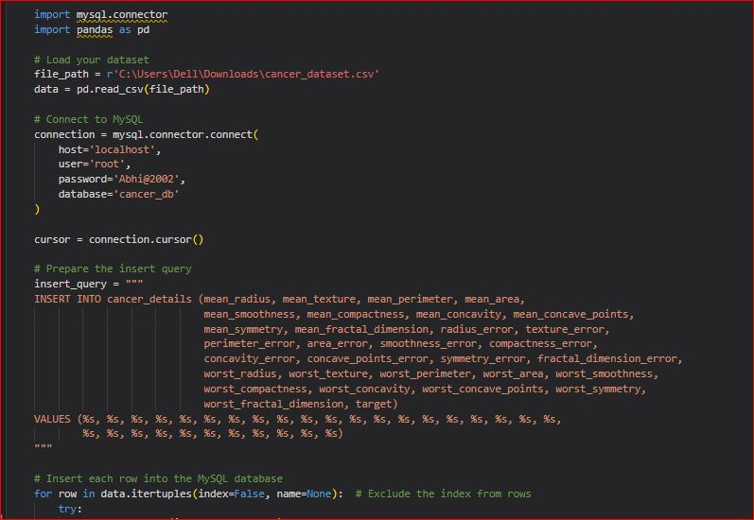
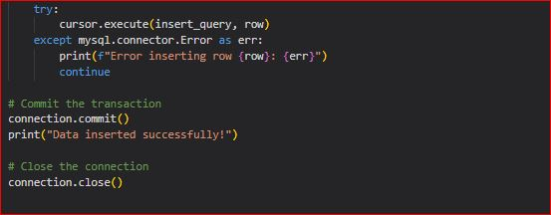
DATABASE CONNECTIVITY
There is a connection object that connects to the MySQL database and is used to insert data from a CSV file into the database via SQL queries in Python Script itself.

Slide 9
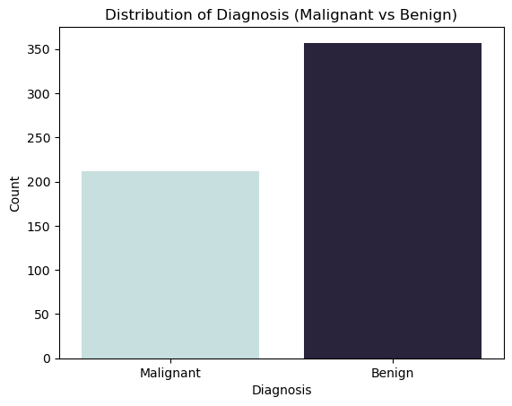
DATA VISUALIZATION
Count Plot: The count plot shows the distribution of the diagnosis categories (e.g., malignant and benign) in your dataset, indicating how frequently each type occurs. The height of each bar represents the count of occurrences for each diagnosis category, providing a clear understanding of the dataset's balance or imbalance between the two classes.

Slide 10
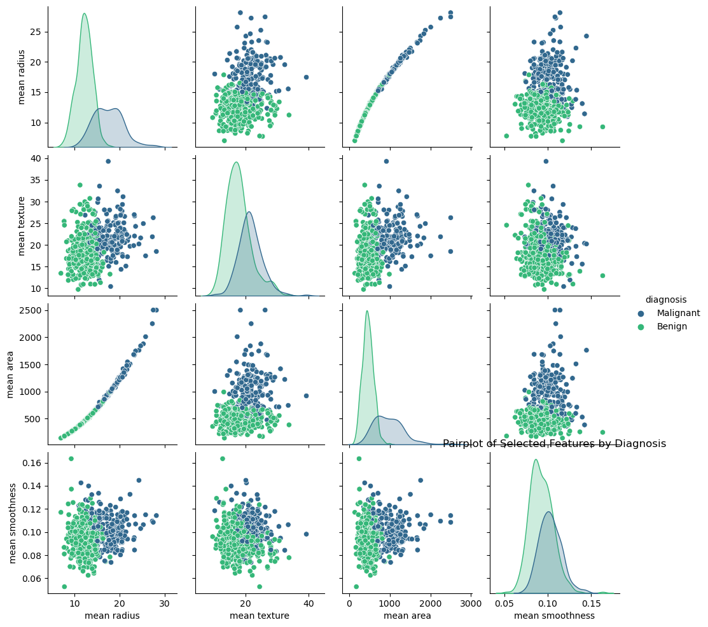
DATA VISUALIZATION
The pair plot visualizes the relationships between multiple features in the dataset, such as 'mean radius', 'mean texture', 'mean area', and 'mean smoothness', while grouping data points by the 'diagnosis' (e.g., malignant or benign). Different diagnoses are represented by distinct colors, allowing you to observe how these features interact and vary between cancer types.

Slide 11
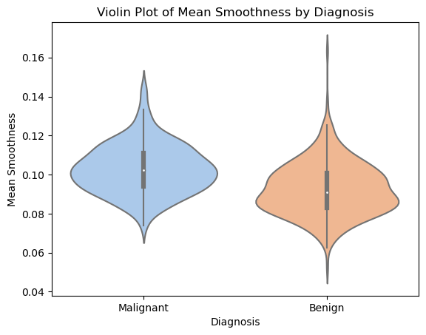
DATA VISUALIZATION
Cat Plot: The cat plot is used here to visualize the relationship between the categorical variable (diagnosis, e.g., malignant or benign) and continuous features such as 'mean radius', 'mean texture', 'mean area', and 'mean smoothness'. It helps to compare the distribution and trends of these continuous variables across the two diagnosis categories, providing insights into how these features differ between malignant and benign cases, which is crucial for predictive modeling and understanding the dataset.

Slide 12
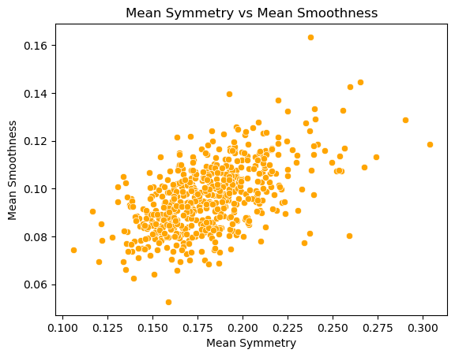
DATA VISUALIZATION
Scatter Plot: The scatter plots visualize the relationships between continuous variables such as 'mean radius', 'mean texture', 'mean area', and 'mean smoothness', with the points differentiated by the categorical variable diagnosis (e.g., malignant or benign).
These plots allow you to observe patterns or correlations between features and how they vary across the two diagnosis categories, helping to identify clusters or trends that are significant for prediction and analysis.

Slide 13
MODELLING
Importing necessary Libraries
Train Test Split
Model Training
Model Prediction
Standard Scalar
Confusion Matrices
Logistic Regression
Support Vector Machine (SVM)
K-Neighbors Classifier
Decision Tree Classifier
Random Forest
Naïve Bayes
XG Boost
Model Evaluation Metrics

Slide 14
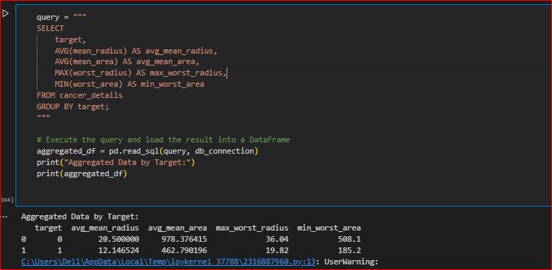
LABEL ENCODING
The cancer data is being encoded into numbers for easier model evaluation

Slide 15
CONCLUSION
This project aims to enhance the understanding of breast cancer prediction by applying data analysis and machine learning techniques. The insights gained from this analysis will provide valuable information for healthcare providers, aiding in the development of more accurate diagnostic tools and improving decision-making in the management of breast cancer treatment.

Slide 16


